Slide 1
MG and DG Workshops 2026/27
Date: 25 February 2026
Virtual Workshop

Slide 2
AGENDA
AGENDA ITEM | PRESENTER
Welcoming | Mr PK Naicker: General Manager: Research, Planning & Report
Opening Comments | Dr Felleng Yende: Chief Executive Officer
SETA Performance | Mr PK Naicker: General Manager: Research, Planning & Research
Quality Assurance Presentation | Ms Zanele Sithole: Learning Programmes & Occupational Qualifications Manager
Skills Planning Presentation | Mr PK Naicker: General Manager: Research, Planning & Report
Demonstration of the Projects LMIS | Mr Bongani Masango: Chief Information Officer
DG Presentation | Mr William Malema: Senior Manager: Operations
Projects Monitoring & Evaluation | Ms Khataza Khosa: Senior Manager: Governance Risk & Compliance
Career Portal | Mr Bongani Masango: Chief Information Officer
Vote of Thanks | Mr PK Naicker: General Manager: Research, Planning & Report

Slide 3
Opening Comments
Chief Executive Officer
Dr Felleng Yende

Slide 4
Welcome to a new year of opportunity and responsibility
A moment to reset, refocus and recommit to our mandate
Skills development remains central to economic recovery and sector growth
Together, we shape the future of the Fibre Processing and Manufacturing Sector

Slide 5
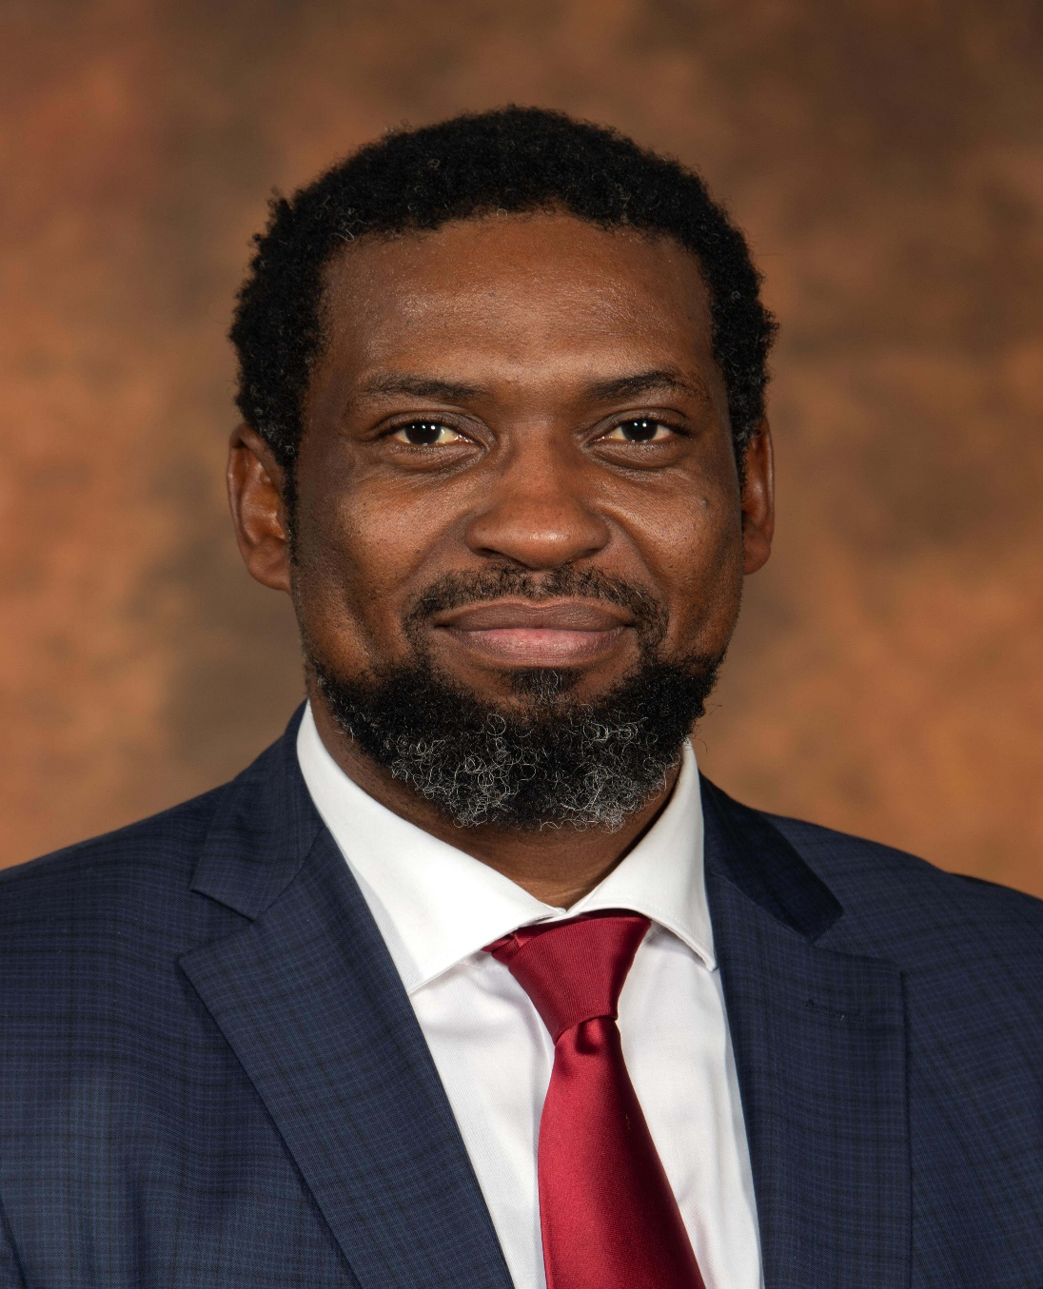
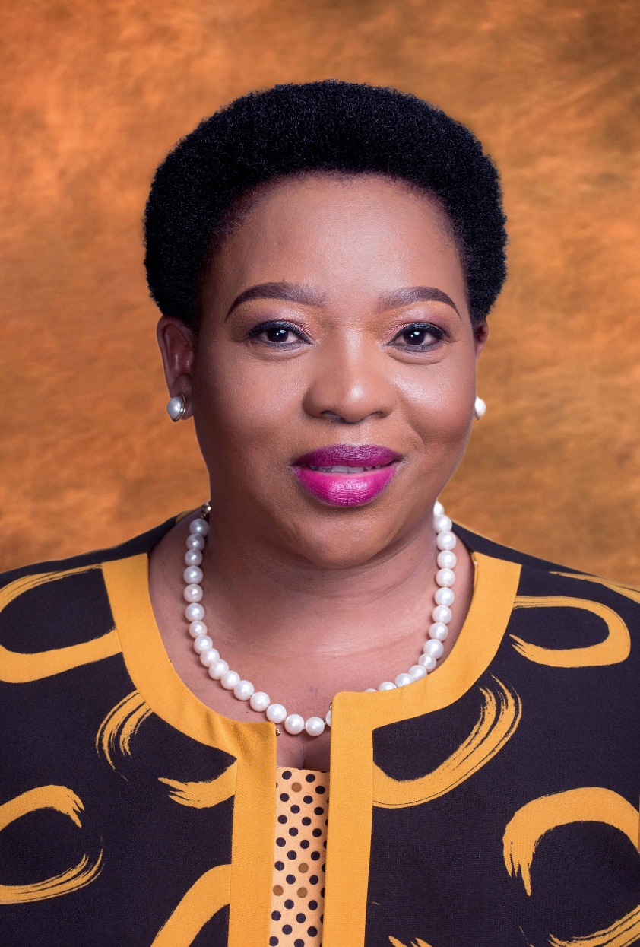
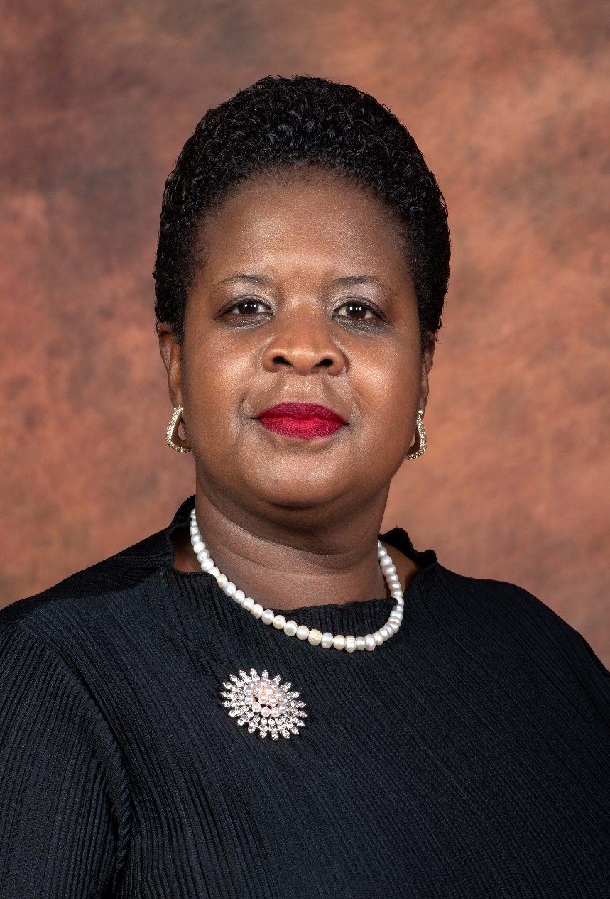
Appreciation: DHET Leadership
Dr Nomusa Dube-Ncube (MP)
Deputy Minister:
Higher Education and Training
Mr Buti Kgwaridi Manamela (MP)
Minister:
Higher Education and Training
Dr Mimmy Gondwe (MP)
Deputy Minister:
Higher Education and Training

Slide 6
Responding to a Changing Skills Landscape
Rapid technological change and digital transformation
Persistent youth unemployment and skills mismatches
Pressure on employers to remain competitive and compliant
Increasing need for credible, data-driven skills planning
Stronger alignment required between training, labour demand and economic priorities

Slide 7

Progress Through Partnerships and Commitment
Continued focus on governance, compliance and performance
Strengthened collaboration with employers, labour and training institutions (TVETs/HEIs)
Expanded access to skills development opportunities for priority groups (People living with Disabilities, Women, Youth, Rural Development, Township Economy)
Improved systems, planning processes and stakeholder engagement
A solid foundation laid for a more responsive and impactful 2026 – Economic Growth/Employability/Entrepreneurship

Slide 8

Emerging Concerns
Stakeholder Reach
Learner stipend/allowance not duly paid by stakeholders
Delayed project activation
Quality of Training
Learner Absorption
Capturing of Learners on the System
Assessment Processes, Final Results & Certification

Slide 9
Challenges Experienced in the Development of Occupational Qualifications
Limited Industry Participation
Difficulty securing consistent involvement from industry experts and employers during the development of Occupational Qualifications
2. Shortage of Subject Matter Experts (SMEs)
Few experienced professionals with both practical expertise and understanding of the EISA instruments development framework.
      Footwear
      Printing
      Packaging
      Wood Products
3. Limited Awareness and Buy-In
  Some industry players lack understanding of the benefits of occupational qualifications, leading to minimal commitment.
  Perception that qualification development is lengthy and bureaucratic discourages engagement.

Slide 10
Appreciation for Industry Participation
We extend our sincere gratitude to the following industries for their invaluable contribution to qualifications development:
  Textiles
  Clothing
  General Goods
  Publishing
  Leather
  Furniture
  Forestry
Your active participation, industry expertise, and ongoing collaboration play a critical role in ensuring that our qualifications remain relevant, responsive, and aligned with current and future skills demands.
The rest of the industries are encouraged to participate in the development of qualifications.

Slide 11
Transitional Arrangements

Slide 12
Extension of Deadline for Implementation
of Transitional Arrangements –
Legacy Qualifications
Stakeholders present were made aware of the published Guidelines on the Implementation and Transitional Arrangements for Pre-2009 Qualifications (Under SAQA Act, 1995) in line with the Ministerial Directive published on 3rd June 2024.
We acknowledge that there are several qualifications identified that have challenges and that need their enrolment and achievement date extended.
The Directive on the implementation and transitional arrangements for the pre-2009 qualifications published in the Government Gazette 50742 on 3rd June 2024 extends the last date of enrolment for particular categories of qualifications for a minimum of one (1) year and a maximum of two (2) years for qualifications that are in the process of realignment, development, evaluation and recommendation to SAQA.

Slide 13
The Shift to QCTO – A Strategic Imperative
We Are Moving From: Legacy qualifications → Occupational qualifications
What Changed?
Standardised national assessments
Greater workplace relevance
Stronger quality and credibility
Provider Readiness for QCTO
Providers Must Start to:
Align programmes to occupational qualifications
Prepare learners for external assessments
Strengthen workplace learning partnerships
Upskill facilitators and assessors

Slide 14
The Shift from Legacy Qualification to QCTOs Occupational Qualifications
Legacy Training Approach | Occupational Qualifications Approach
Primarily classroom-based with heavy theory focus. | Integrated learning combining knowledge, practical training, and workplace experience.
Unit-standard driven, often resulting in fragmented learning. | Structured curriculum with clear learning pathways.
Workplace learning was limited or not applied. | Mandatory workplace exposure aligned to occupational competence.
Provider-led assessments with varying levels of standardisation. | External Integrated Summative Assessment ensuring consistency and quality.
Focused on achieving credits and completing qualifications. | Focused on producing job-ready, competent graduates.
The transition signals a strategic shift from knowledge-based training to workplace competence, strengthening employability and industry alignment.

Slide 15
Performance Overview

Slide 16

SETA Mandate
Responsible for the Implementation of a Sector Skills Development Strategy for the FP&M Sector
Promotion and implementation of the objectives of the NSDP
  Provision of skills development services to FP&M Sector, including:
  Disbursement of mandatory grants linked to workplace skills planning
  Disbursement of discretionary grants for the implementation of learning programmes and sector specific projects
  Quality assurance of learning provision, including qualifications development
  Facilitation of programmes / projects to ensure that people (employed or wanting to be employed in the sector) obtain the SPOI that are needed to build the capacity of the sector to become economically sustainable and globally competitive

Slide 17
Strategic Overview
VISION
MISSION
VALUES
To be an innovative skills development partner supporting high-quality learning and development interventions towards global competitiveness, an inclusive economy, and decent work.
To evolve as an agile and ethical institution that facilitates an efficient and effective skills development process contributing
to the achievement of sector competitiveness, transformation
and economic growth.
Integrity
Accountability
Respect
Service Excellence
Inclusive, Sustainable, Socio-Economic Transformational
Interventions
STRATEGIC SCORECARD
World Class Performance
Meeting Industry Standards
Business and Government Trust
Public Trust

Slide 18
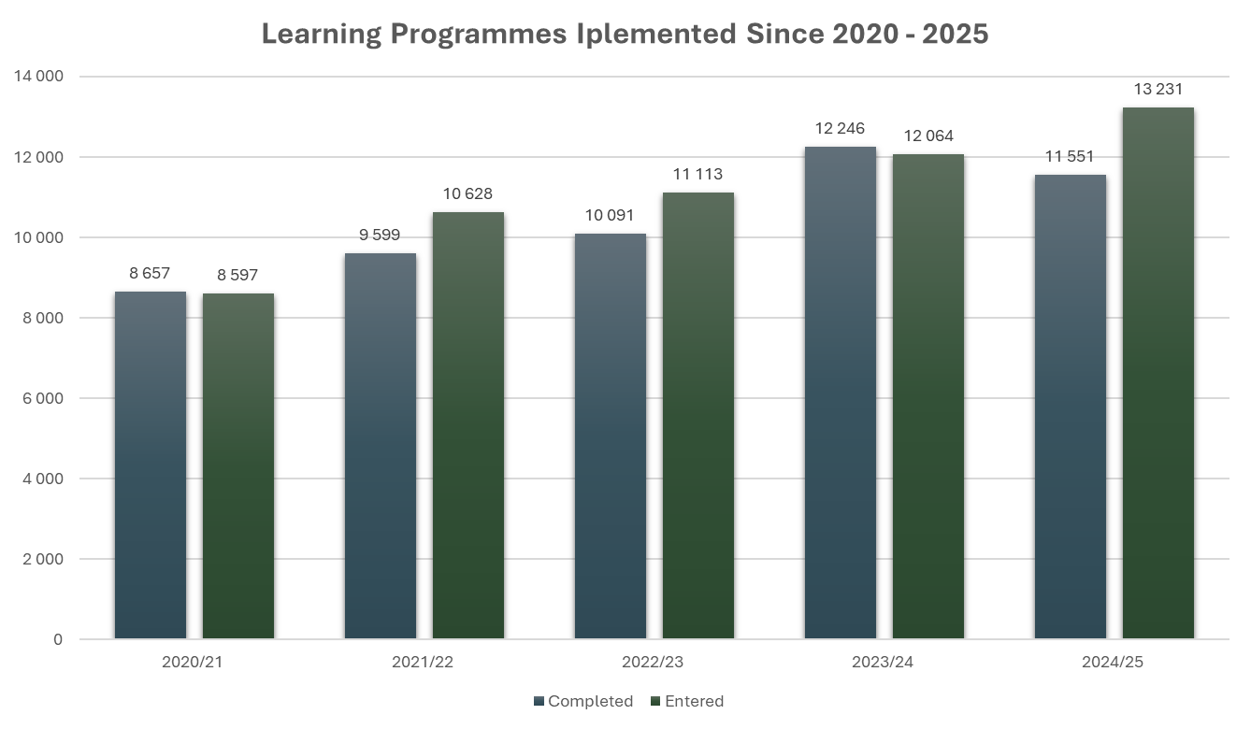
Learning Programmes Implementation 2020/21 – 2024/25
These occupationally directed programmes promote skills development in the workplace, enhancing skills, enabling better productivity, and addressing scarce and critical skills within the FP&M sector through pivotal interventions.
2024/25
13 231 learner registrations - 11 551 completions

Slide 19

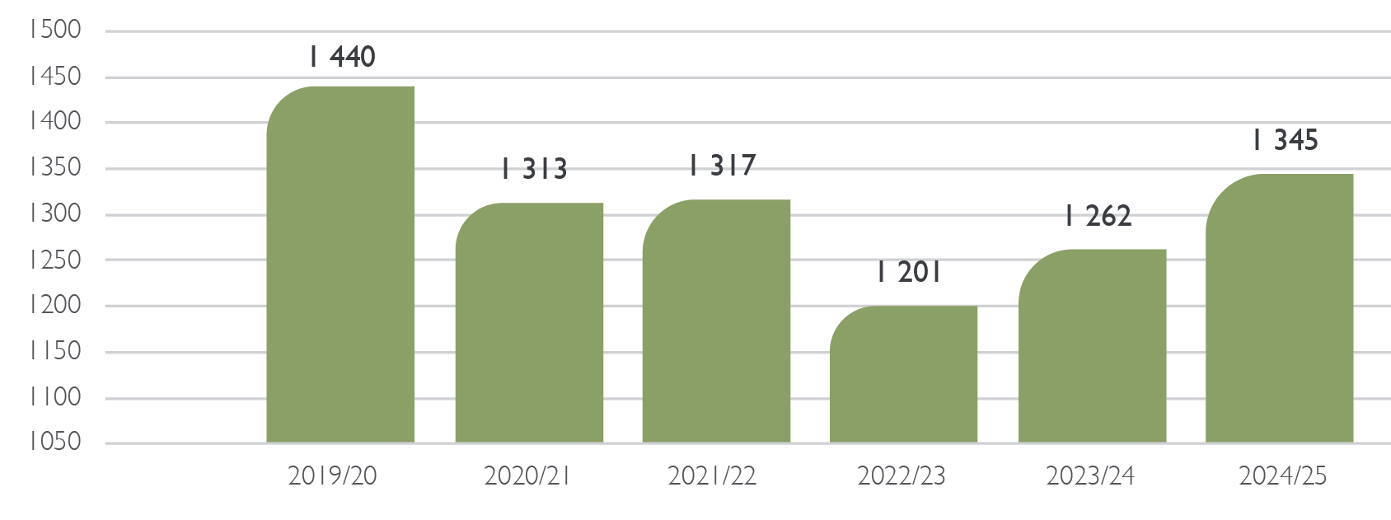


WSP/ATR Submissions
2019/20 – 2024/25

Slide 20

Key Strategic Period Achievements
4/5
clean audit outcomes in the last 5 years
Expanded workplace-based learning and online delivery (national reach)
Digital shift: LMIS, ERP, e-Qualifications portal operational.
96%
overall performance achievement in the last five financial years
Significant qualifications development: 130 occupational qualifications (76 with learning material)
Transformation Gains
63.6% female
99.6% black
78% youth
1.1% disability (needs uplift)
Strengthened stakeholder engagement and career pipeline (career guide and portal)
Sector employment resilience despite macroeconomic headwinds

Slide 21
FP&M SETA
Audit Outcomes

Slide 22
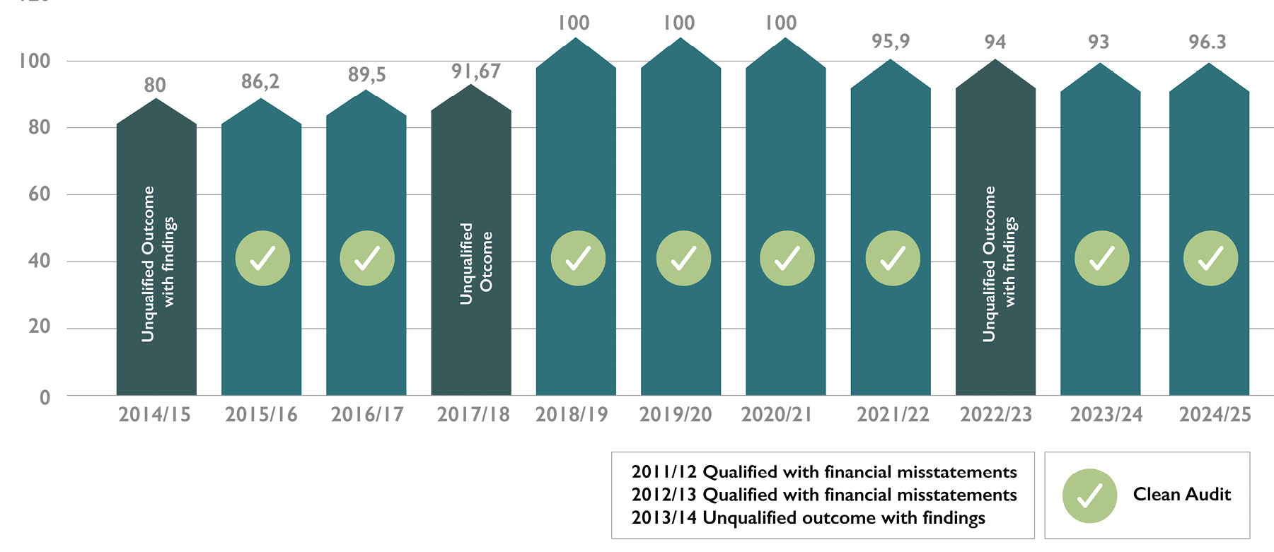
Performance Against APP Targets and Audit Outcomes
2020/21 – 2024/25

Slide 23
THANK YOU

