Slide 1
IT System Presentation

Slide 2
ILMIS Enhancement for System Effectiveness
Requirement
Analysis
Design
Development
Testing
Deployment
Maitenance
Enhancements Definitions
Methodology: Agile and Dev-Ops
How enhancements are solicited
PROJECT MODULE ENHANCEMENT
Commitment for absorption Percentage
Disability selection option
Digital Signature
Auto-populate key information from current submissions, during a DG Application. E.g., Company details, contact information, and address.
Single update for one profile on multiple modules

Slide 3
LMIS ENHANCEMENT FOR SYSTEM EFFECTIVENESS
SP&R MODULE ENHANCEMENT
Prepare submission data early and avoid last-minute information capturing
Training Intervention
Employee data
Training Planned / Implemented
Retrieve previous years’ submission data, therefore allowing stakeholders to update information and capture less data.
More training and support on Excel capturing
Single update for one profile on multiple modules

Slide 4
ILMIS Enhancement For System Effectiveness: QA Module Enhancement
Integration to Home affairs to verify learners at capturing and completion
Learners' status at completion of the program
Employed,
Further studies
Entrepreneurship
Unemployed
Auto enrol learners which are verified when creating a class.
Allow multiple SDF Registration for both SETA Funded and Industry Funded
All Learner Supporting document should be loaded on the system for verification across all intervention , including SETA and Funded Industry
QTCO Accredited SDP on FP&M SETA programs are now linked on the training providers profile within the LMIS
If you link Occupational qualifications the Modules will auto populate

Slide 5

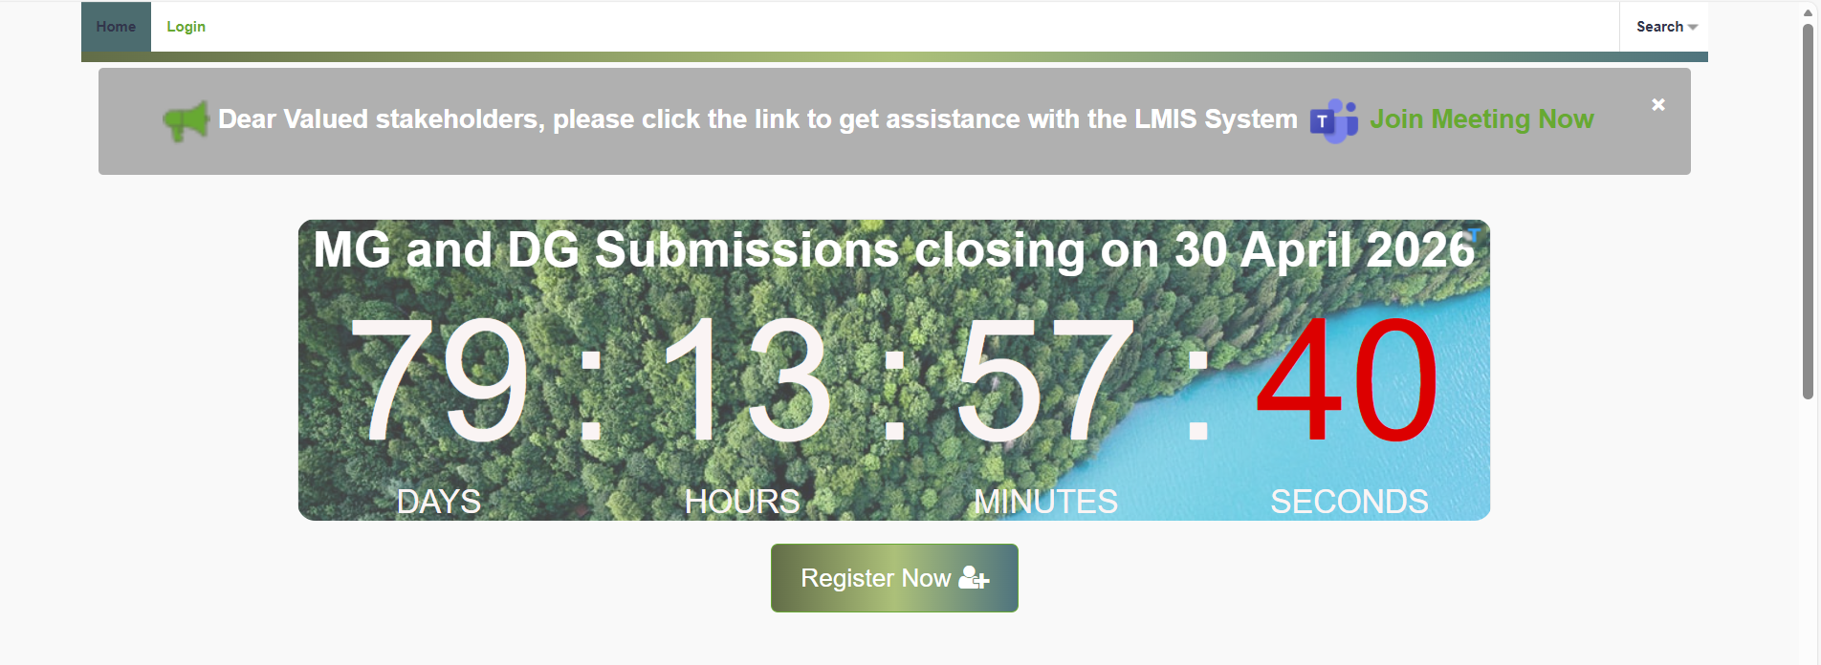
ILMIS Live Demonstration and Support
Online Support Team through team
Weekly training and support for Stakeholders
User Manuals and demonstration videos
Ticket Reference Numbers
Support Service Rating
https://fpmseta.endorseds.co.za/

Slide 6
Career Portal Update: Background, Status and Progress
Database of the qualified candidates \ learners
Bridging the gap between qualified candidates and employers
12890 Qualified Registered candidates \ learners
Career Portal Revamped
Advertised Opportunities (Extremely low and we need more for better impact)
Continuous updating of learners and available opportunities
Create more awareness of the portal during DG and MG workshops
https://www.careers-fpmseta.org.za/

Slide 7
e-Qualification Portal

Slide 8
e-QUALIFICATION UPDATE
Background, Status and Progress
FP&M SETA has deployed a value-add e-qualifications solution that will assist stakeholders in conducting blended learning, online assessment, moderation, and content upload
SDP can manage learners and documentation on the solution
Registered occupational qualifications are being digitized and uploaded on the platform
Seventeen (17) approved Occupational Qualifications in the process of digitization
System is accessible to unlimited
PR company and Coms team have completed reviewing content
https://fpmlearning.org.za/

Slide 9
Chief Information Officer Mr. Bongani Masango – 011 403 1700 bongnim@fpmseta.org.za
IT SUPPORT
Business System Support (Career and e-Qualifcation Portal)
Mpumelelo Mthethwa
011 403 1700
MpumeleloM@fpmseta.org.za
LMIS SUPPORT
Consultants
011 403 1700
Helpdesk@fpmseta.org.za
Live teams support click link below Join conversation
INFRASTRUCTURE SUPPORT
Computer System Specialist
Jan Molekwa
011 403 1700
JanM@fpmseta.org.za
Durban
IT Administrator
Thulisile Ngubane
031 702 4482
ThulisileN@fpmseta.org.za

Slide 10
Thank You

