Slide 1
MG and DG Workshops 2026/27
Date: 11 February 2026
Province: Kwazulu-Natal

Slide 2
CONTENTS
Introduction to M&E
M&E Framework
M&E Implementation Strategy
Verifications of 1st Time Approvals
Site Visit Timelines
Pre-Site Visit Preparations
Project Implementation Risks
Implications of Non-Compliance

Slide 3

Monitoring & Evaluation
The FP&M SETA has implemented a robust Monitoring and Evaluation strategy to assess the implementation of DG/MG funded projects, ensure compliance of the Skills Development Providers and to report to governance structures & stakeholders.
The FP&M SETA has implemented a robust Monitoring and Evaluation strategy to assess the implementation of DG/MG funded projects, ensure compliance of the Skills Development Providers and to report to governance structures & stakeholders.

Slide 4





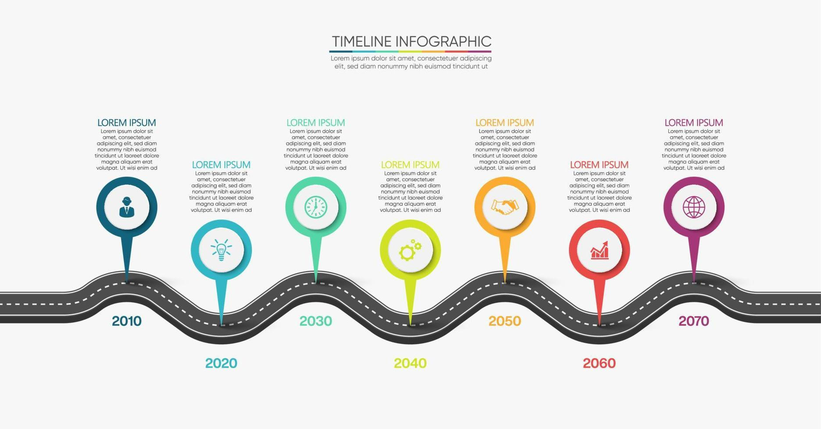










M&E Implementation Strategy
Incident Reports are submitted to the Projects & QA Divisions for implementation of remedial actions.
ISSA’s arrange site visits in accordance with their Project schedules.
The signed site visit reports are uploaded on the system.
A follow-up, is made with the Divisions on the close-off of issues noted.
ISSA’s conduct review using the M&E Check List provided by the SETA.
Reports are analysed & risk incidents or observations are documented.
Status of the Incidents documented are reported to CEO.
4

Slide 5
Due Diligence Reviews
The purpose of this due diligence site visit is to determine compliance with FP&M SETA due diligence standards and practices to gain assurance on professional delivery and implementation of projects.
The scope of the due diligence review is as follows:
Facilities
Equipment
Disability Compliance
Performance History
Delivery & administration
Staff & Resources
Accreditation
Ethics & Governance
Physical Resources
FP&M SETA reserves the right to conduct due diligence reviews on any organisation that intends to contract, partner and collaborate with the SETA.
Please note that a Due Diligence review is not a commitment to contract or appoint, but a compliance exercise.

Slide 6

Pre-visit Preparations
An M&E review seeks to grant assurance regarding project implementation therefore in preparation of the visit the following documents must be readily available:
Implementation plans
Learning programme
Learner agreements
Accreditation documents
Learner records
Proof of learner stipend payments
Compliance Documents ( COIDA, OSHA etc.)
Attendance registers
Portfolio of Evidence (POE)
Logbooks (apprenticeships)
MoA’s/Annexures

Slide 7


Project Implementation Risks
Learner stipend/allowance not duly paid by stakeholders.
Unavailability of stakeholders for M&E Reviews hampering assurance of project implementation
Non-Compliance with the terms and conditions of the agreed and signed MOA
Non-Compliance with approved FP&M SETA policies
Delayed submission of accurate and complete information
Inaccurate learner records
Delayed project activation
Deceased Learners

Slide 8
DECEASED LEARNERS
The SETA expects the following procedures to be followed in the event of deceased learners:
Immediate formal disclosure
Replacement learners
CEASE submission of claims on deceased learners

Slide 9
Implications of Non-compliance
Depending on the severity of the issues reported, where suspicion of contractual and or legal breaches, malpractice, unethical conduct & governance risks occur M&E may recommend:
formal investigation of allegation/s
Suspension of the implementation of the project
Suspension and or revoking accreditation of the training provider
Blacklisting the training provider/institution
Withholding payments due
Reporting the matter to the authorities for further legal action
9

Slide 10
CONTACT DETAILS
Ms. Khataza Khosa
Senior Manager: GRC
011 403 1700
KhatazaK@fpmseta.org.za
Mr. Zwelakhe Mbatha
M&E: Specialist
011 403 1700
ZwelakheM@fpmseta.org.za
Mr Simamkele Tshete
011 403 1700
SimamkeleT@fpmseta.org.za
Ms Nonhlanhla Nhlapho
011 403 1700
NonhlanhlaN@fpmseta.org.za

Slide 11
Thank You
Contact us

